Slide 1


Slide 2

AWT is Java’s original set of classes for building GUIs
  Uses peer components of the OS; heavyweight
  Not truly portable: looks different and lays out inconsistently on different OSs
    Due to OS’s underlying display management system
Swing is designed to solve AWT’s problems
  99% java; lightweight components
    Drawing of components is done in java
    Uses 4 of AWTs components
      Window, frame, dialog, ?
  Lays out consistently on all OSs
  Uses AWT event handling

Slide 3

Import javax.swing.*, java.io.*, java.awt.*
Make a specific class to do GUI functions
Specify all the GUI functions/components in the class’s constructor (or methods / classes called by the constructor)
Run the GUI by instantiating the class in the class’s main method

Slide 4
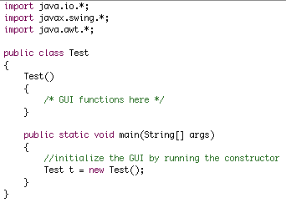

Slide 5

Frames are the basis of any Java GUI
Frame is the actual window that encompasses your GUI objects; a GUI can have multiple frames
The “J” prefix is at the beginning of any Swing component’s name (to distinguish them from AWT components)
JFrame is a wrapper around AWT’s Frame

Slide 6

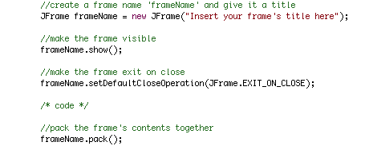

Slide 7

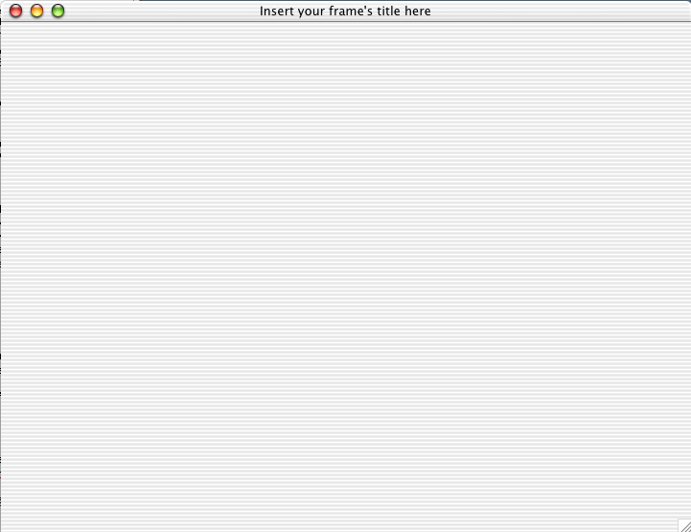

Slide 8

The terms “pane” and “panel” are used interchangeably in Java
If a frame is a window, a pane is the glass
Panes hold a window’s GUI components
Every frame has at least one pane, the default “Content Pane”

Slide 9

Useful for layout
  If you want to group certain GUI components together, put them inside a pane, then add that pane to the frame
Needed to add components to the frame
  Nothing can be added directly to the frame; instead, everything, including other panes, is added to the frame’s content pane

Slide 10

When a frame is created, the content pane is created with it
To add a component to the content pane (and thus to the frame), use:
  frameName.getContentPane().add(component name);
  where frameName is the name of the frame

Slide 11

Specified by Java’s JTextarea class
Multiple constructors allow you to create a new text area with a specified size and/or specified text
A text area is just a white space of variable size that can hold text
If text goes out of the area’s bounds, it will exist but some of it will not be seen
  Wrap the text area in a scrollable pane

Slide 12
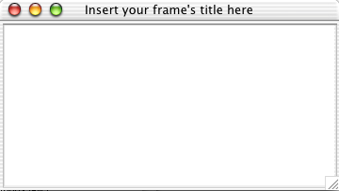

Slide 13

textarea.setText(String);
textarea.getText(String);
textarea.append(String);
textarea.setEditable(boolean);

Slide 14

Similar to a regular pane, only, when necessary, a scrollbar appears to allow scrolling through the pane’s contents
Particularly useful for embedding tables and text areas, as these tend to contain more content than they can show at one time

Slide 15
Default constructor (JScrollPane()) creates a scrollable pane that you can add components to
Alternatively, you can initialize a pane to wrap itself around a component
  JScrollPane newPane = new JScrollPane(JTextArea area);

Slide 16
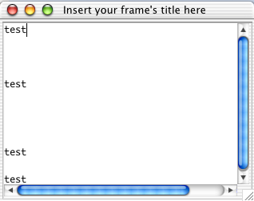

Slide 17

A Java text field is essentially the same as a text area, only limited to one line
Very similar set of methods
JPasswordField is the same as JTextField, only the contents are hidden
Different constructors allow you to predefine the number of columns and/or the default text

Slide 18

Java class that allows you to define a button
Multiple constructors allow you to initialize a button with a predefined label and/or a predefined icon
Although the button’s “action” can be defined in the constructor, defining a button’s action can take many lines of code and should be done separately

Slide 19

JButton button = new JButton(“Press Me!”);
button.addActionListener(new ActionListener() {
public void actionPerformed(ActionEvent e) {
/* insert action here */
}
});
/* setting an action requires that you import java.awt.event.* */

Slide 20

Design pattern often used in Swing objects
Breaks a GUI object down into three parts
  “Model” manages the data used by the object
  “View” manages the graphical/textual output of the object
  “Controller” interprets user input, commanding the model and view to change as necessary

Slide 21
Swing components that use the MVC pattern, such as JList and JTable, generally have one class that controls both the view and the controller and a separate class that controls the model

Slide 22
Programmer instantiates a model (e.g., the DefaultTableModel class), then loads that model with the data to be displayed in the GUI
The view/controller class (e.g., the JTable class) is then instantiated from the model
  JTable table = new JTable(DefaultTableModel model);
If the programmer instantiates the GUI object without a model, the view/controller class creates an empty model to work from

Slide 23


A simple GUI object design to hold lists of objects and allow users to make selections from the list
Can be created from a ListModel, a Vector, or an array (all essentially lists themselves)

Slide 24

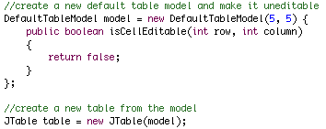
Usually created from a DefaultTableModel
  Can also be created from an array of arrays or a Vector of Vectors, or can have no initial data
Create a DefaultTableModel, then initialize a table from the DefaultTableModel

Slide 25
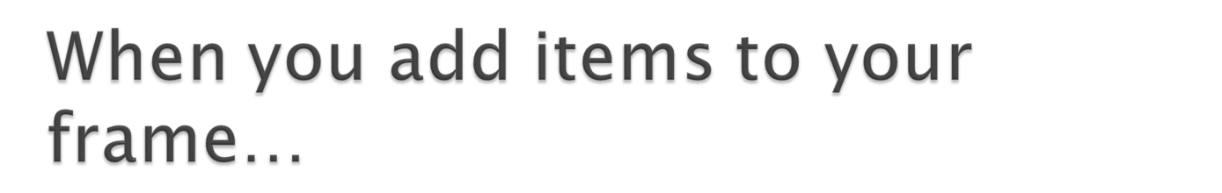
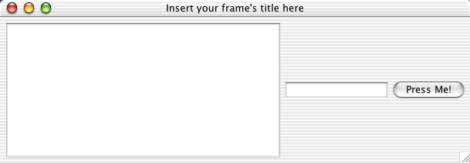
Text area is added first, then text field, then button

Slide 26

Every pane has a layout manager
Layout managers tell Java where to put components when you add them to a pane
The default layout manager is FlowLayout, which lays out components from left to right until there is no room left on a line, then starts the next line
Lays out components in the order they are added
Layouts can be nested, one inside of another making them quite versatile

Slide 27

BorderLayout
  Defines five regions: North, South, East, West, and Center
  Programmer specifies which objects go to which regions
GridLayout
  Programmer defines matrix dimensions; objects are then put in the matrix in the order they are added, left to right, top to bottom

Slide 28

BoxLayout is a simple way to come close to absolute positioning (which isn’t recommended)
  Panes can be laid out either top to bottom or left to right
  Panes laid out with BoxLayout can be put in other BoxLayout panes, creating a grid of completely variable size and a very controlled layout

Slide 29
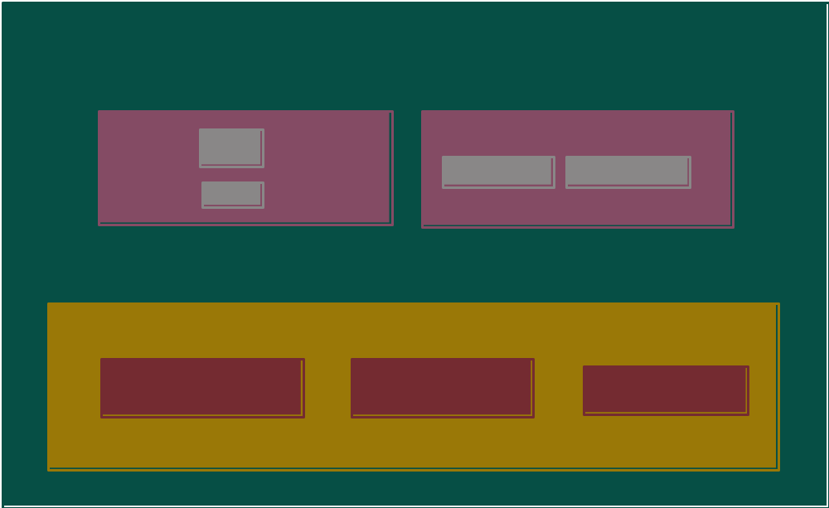

Slide 30
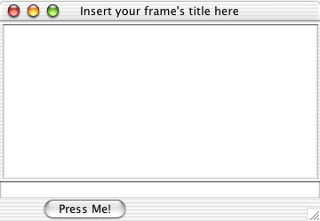
Pane.setLayout(new BoxLayout(Pane, BoxLayout.Y_AXIS));
where Pane is the name of the pane you are laying out

Slide 31

Components (AWT and Swing) generate events in response to user actions
  (button clicks, mouse movement, item selection…)
  different components generate different events
    Buttons generate “action” events
    Cursor movement generates “mouse events”
    ect.
  The program must provide event handlers to catch and process events
    Unprocessed events are passed up through the event hierarchy and handled by a default (do nothing) handler

